Slide 1
Introduction to Machine Learning. Basic Concepts and Learning Paradigms.
Radu Ionescu, Prof. PhD.
raducu.ionescu@gmail.com
Faculty of Mathematics and Computer Science
University of Bucharest

Slide 2
Machine Learning
Artificial Intelligence
Natural Language
Processing
Machine
Learning
Kernel Methods
Deep Learning
Nearest Neighbors
Knowledge
Representation
Markov Models
K-means
Expert Systems
Random Forest
Bayesian Models
Hierarchical Clustering
Computer Vision
Image Processing
Signal Processing

Slide 3
Instructors
Lectures:
Radu Ionescu (raducu.ionescu@gmail.com)
Labs:
Alin Croitoru (alincroitoru97@gmail.com)
Eduard Poesina (eduardgabriel.poe@gmail.com)
Vlad Hondru (vlad.hondru25@gmail.com)
Website:
https://practical-ml-fmi.github.io/ML/

Slide 4
Grading System
Your final grade is composed of:
50% for Project 1
50% for Project 2
Both projects are individual!
Each project consists of employing machine learning methods on a specific data set
Project 1 is about participating in a Kaggle competition
The competition will be launched in a couple of weeks
Project 2 is about comparing two unsupervised approaches
There are many datasets out there, so no overlap allowed among students!
Methods and data sets must be chosen beforehand!

Slide 5
Grading System
Project 1 must be presented no later than week 10
Project 2 must be presented no later than the day of the “exam”
There will be no paper exam, only oral exam!
The average grade of projects 1 and 2 must be >= 5
The project consists of the code implementation in Python (any library is allowed) and a PDF report including (2 points):
a description of the data set (for project 2 only)
a description of the implemented machine learning methods
figures and / or tables with results / hyperparameter tuning
comments / interpretation for the results
conclusion

Slide 6
Grading System
First project consists of implementing some machine learning method(s) for the proposed Kaggle challenge (TBA)
The grades will be proportional to your model’s accuracy:
- Top 1-20 => your grade can be up to 10
- Top 21-50 => your grade can be up to 9
- Top 51-80 => your grade can be up to 8
- Top 81-100 => your grade can be up to 7
- Top 101-120 => your grade can be up to 6
- Others => your grade can be up to 5
Ranks can change depending on the final number of participants

Slide 7
Grading System
Submit projects to: practical.ml.fmi@gmail.com
Submit only .py files only! (.ipynb not accepted)
We will set deadlines (during every evaluation session) for:
choosing the project
submitting the project
presenting the project
If you don’t know the dates, please ask! Don’t wait until the presentation day!

Slide 8
Grading System
Extra points during lectures / labs
awarded only in the first round of evaluation
Lectures:
awarded based on the ranking of answers on Kahoot
top 3 get up to 0.3 points per lecture, next 3 up to 0.2 points and so on
Labs:
first to answer solve an exercise gets 0.2 points
maximum 0.4 points per lab for each student
Up to 1 bonus point during lectures (added to final grade)
Up to 1 bonus point during labs (added to final grade)
Maybe up to 2 bonus points for some data annotation (TBD)

Slide 9
(NO) Collaboration Policy
Collaboration
Each student must write their own code for the project(s)
Borrowing code from web sources with copy & paste is not permitted under any circumstances
No tolerance on plagiarism
Neither ethical nor in your best interest
Code will be checked automatically and manually!
Don’t cheat. We will find out!

Slide 10
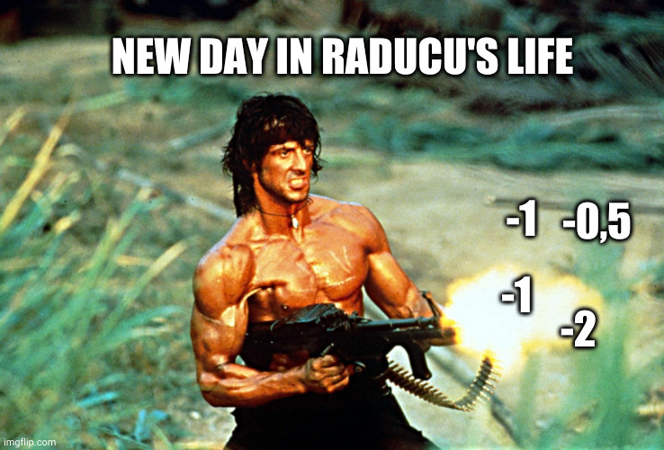
We are serious about this!

Slide 11
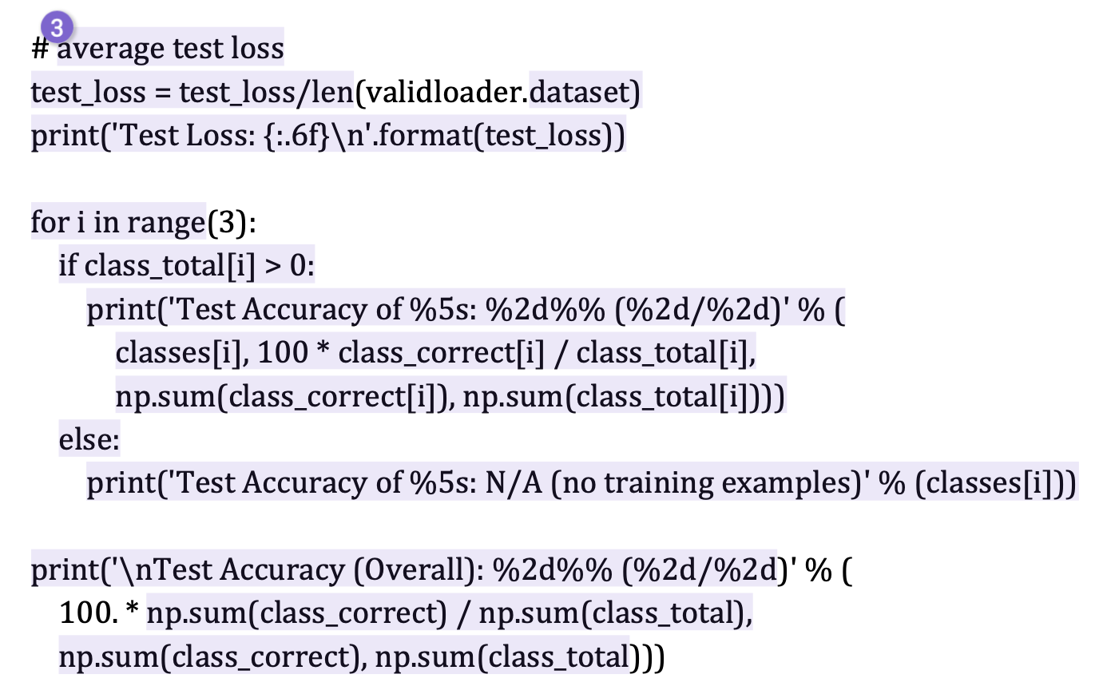
Examples of unacceptable plagiarism

Slide 12
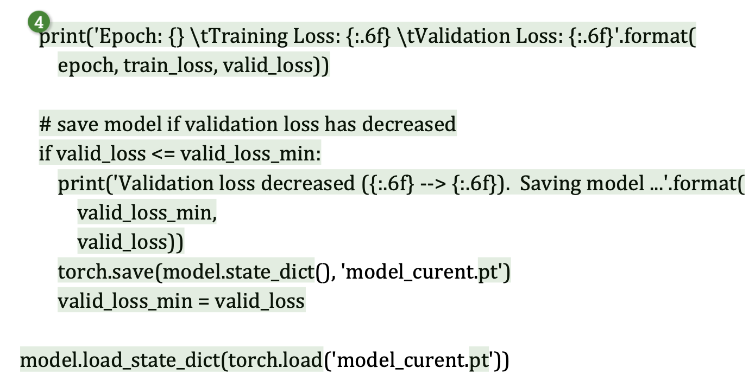
Examples of unacceptable plagiarism

Slide 13
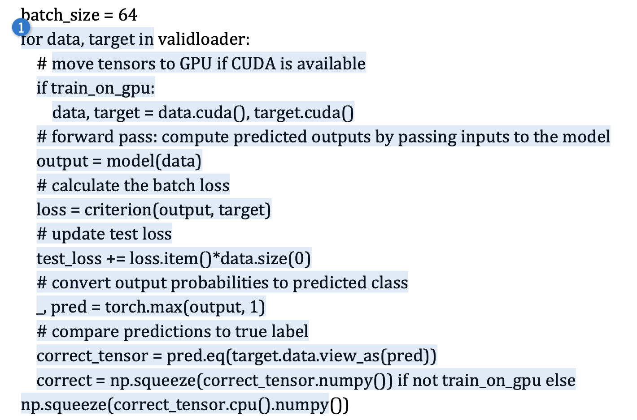
Examples of unacceptable plagiarism

Slide 14
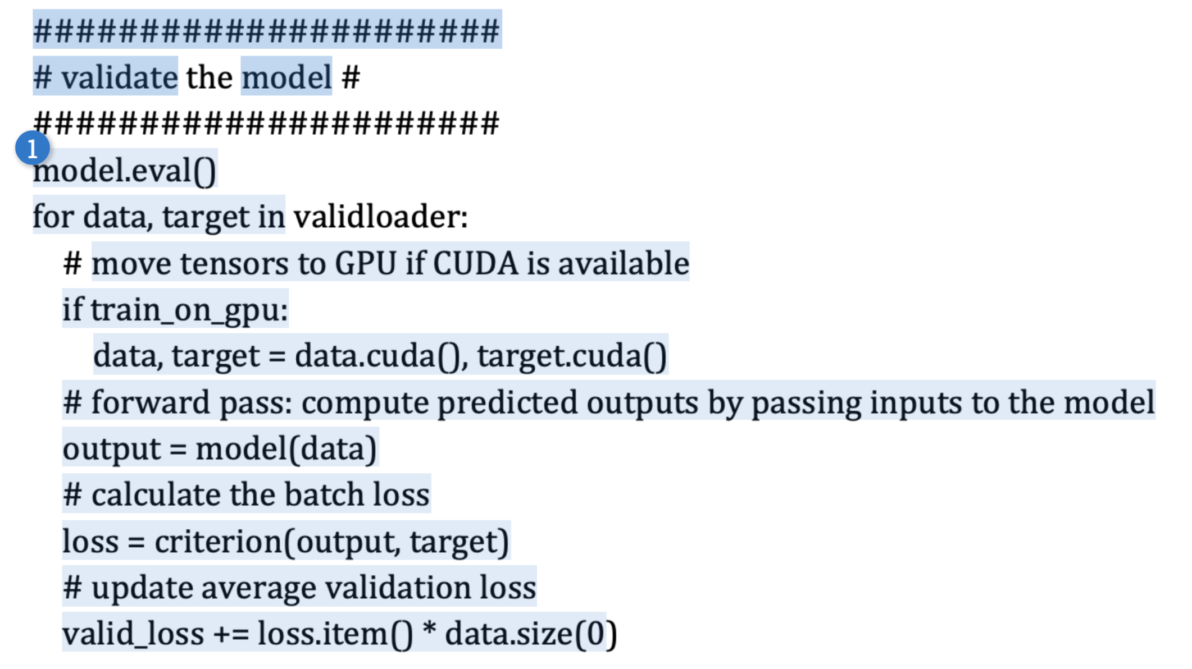
Examples of unacceptable plagiarism

Slide 15
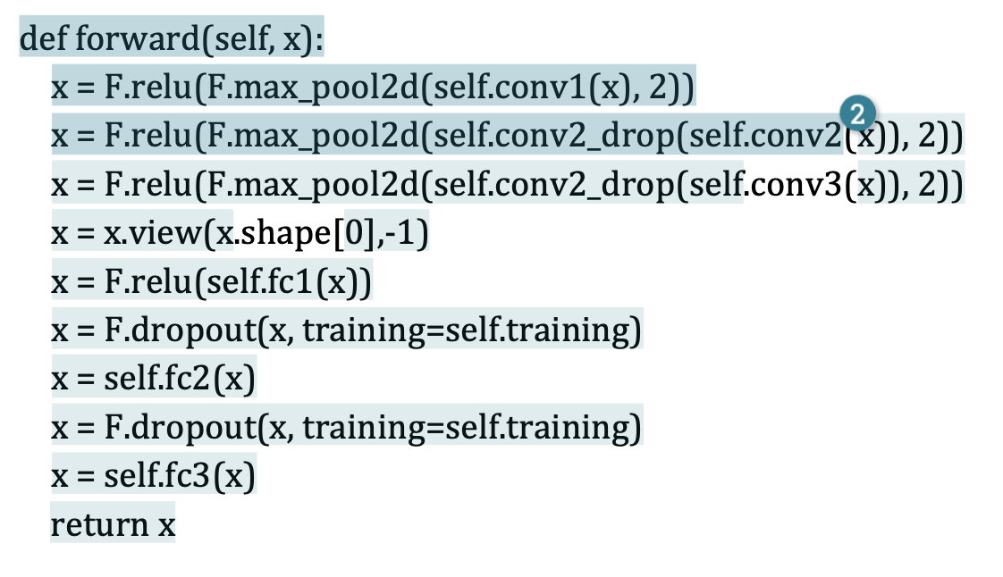
Examples of unacceptable plagiarism

Slide 16
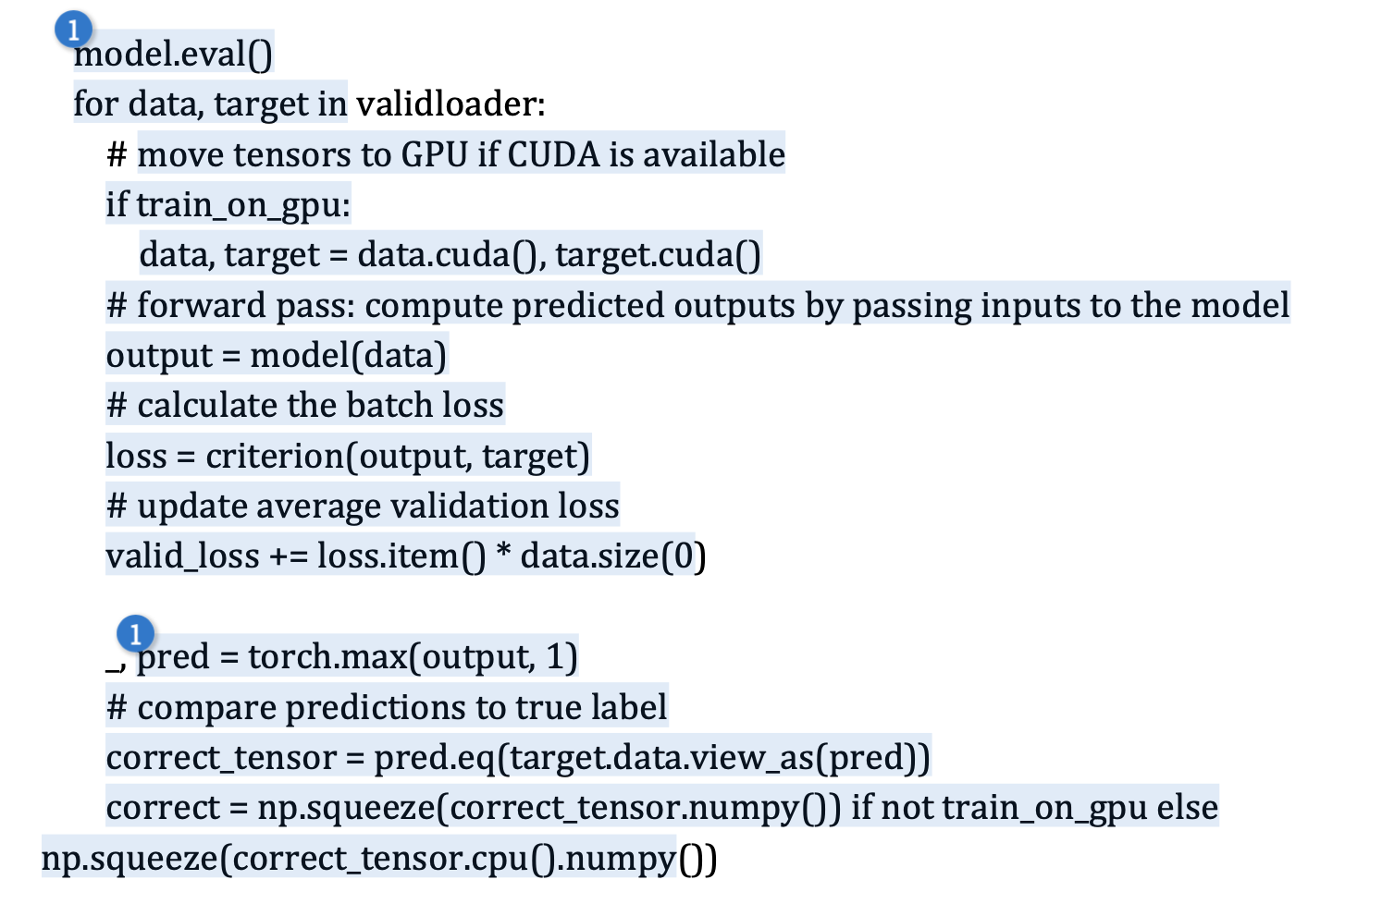
Examples of unacceptable plagiarism

Slide 17
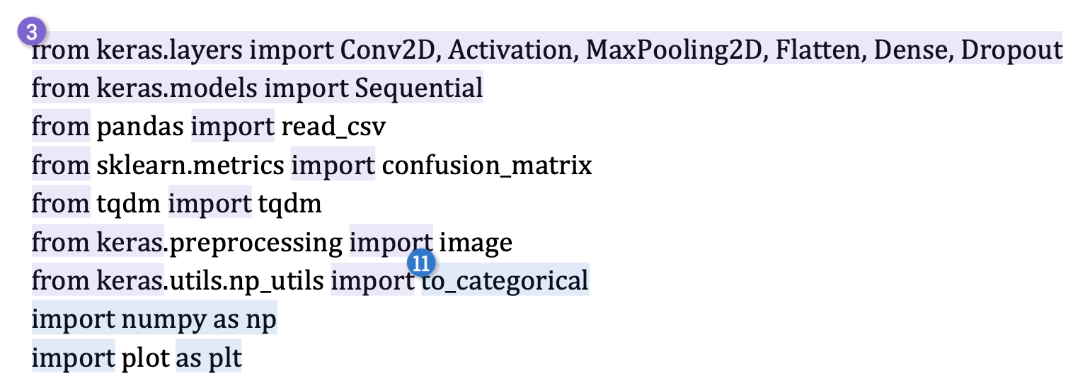
Examples of acceptable code

Slide 18
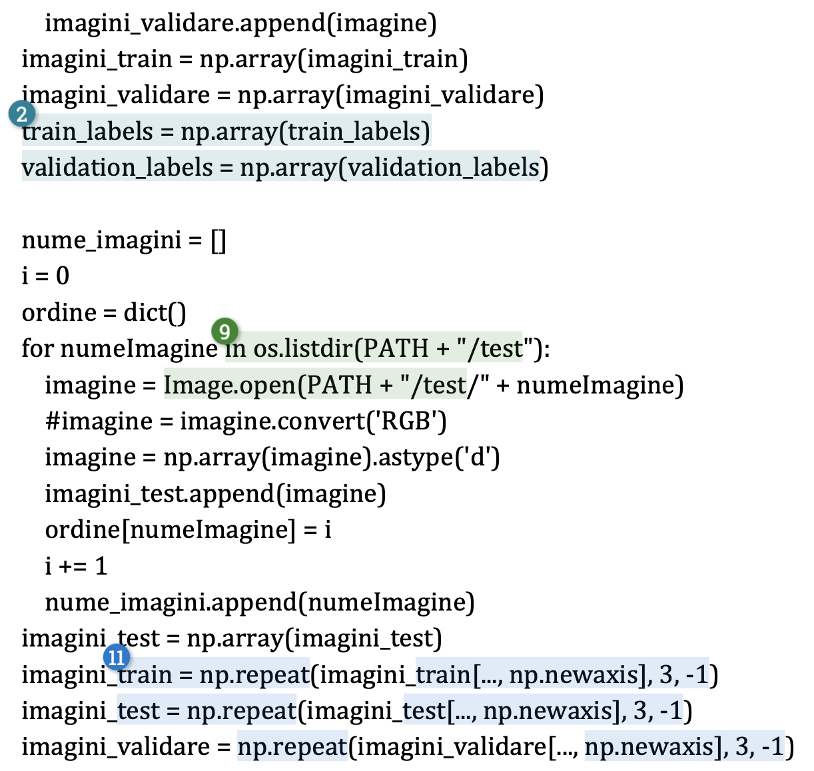
Examples of acceptable code

Slide 19
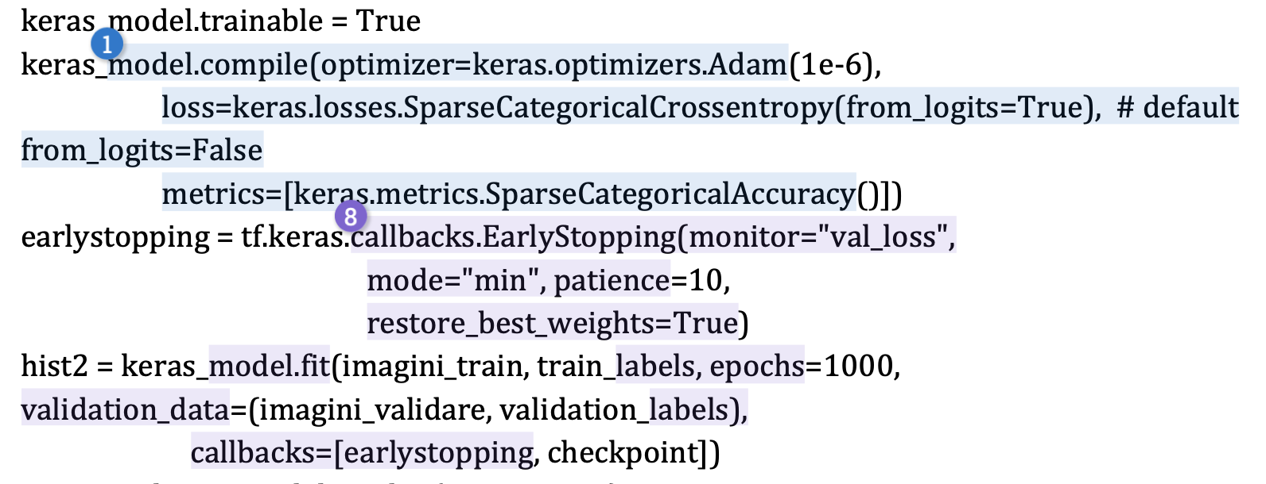
Examples of acceptable code

Slide 20
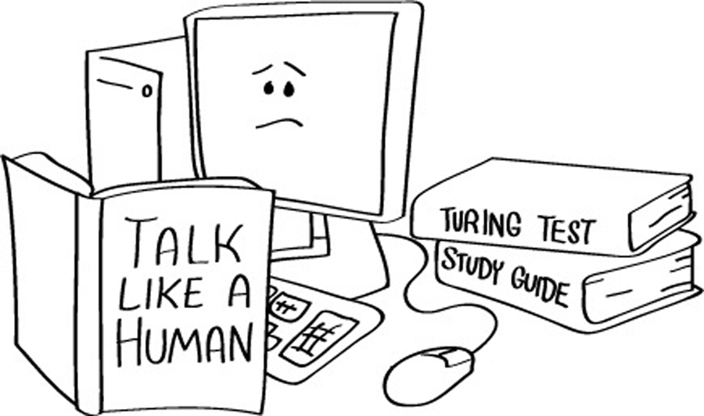
What is artificial intelligence (AI)?
The ultimate goal of artificial intelligence is to build systems able to reach human intelligence levels
Turing test: a computer is said to possess human-level intelligence if a remote human interrogator, within a fixed time frame, cannot distinguish between the computer and a human subject based on their replies to various questions posed by the interrogator

Slide 21
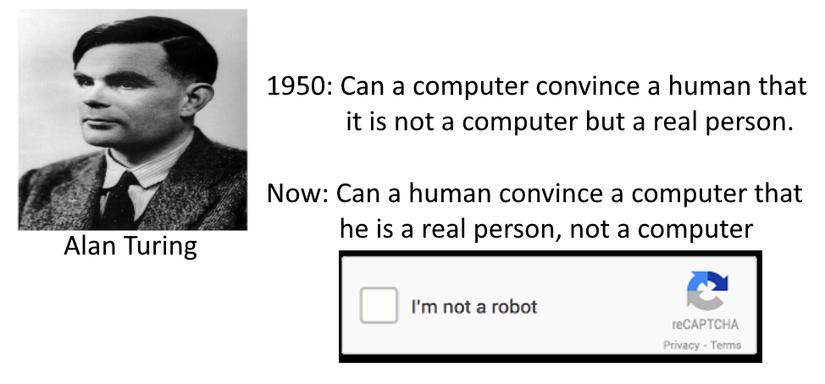
Perhaps we are going in the right direction?

Slide 22
What is machine learning (ML)?
Many AI researchers consider the ultimate goal of AI can be achieved by imitating the way humans learn
Machine Learning – is the scientific study of algorithms and statistical models that computer systems use to learn from observations, without being explicitly programmed
In this context, learning refers to:
recognizing complex patterns in data
making intelligent decisions based on data observations

Slide 23
Classic Programming
Data
Computer
Output
Program
Machine Learning
Data
Computer
Program
Output

Slide 24
A well-posed machine learning problem
What problems can be solved* with machine learning?
Well-posed machine learning problem:
"A computer program is said to learn from experience E with respect to some class of tasks T and performance measure P, if its performance at tasks in T, as measured by P, improves with experience E.” – Tom Mitchell
(*) implies a certain degree of accuracy

Slide 25
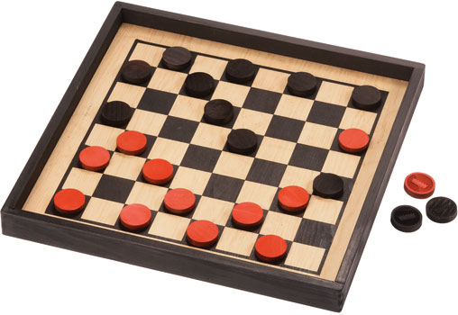
A well-posed machine learning problem
Arthur Samuel (1959) wrote a program for playing checkers (perhaps the first program based on the concept of learning, as defined by Tom Mitchell)
The program played 10K games against itself
The program was designed to find the good and bad positions on the board from the current state, based on the probability of winning or losing
In this example:
E = 10000 games
T = play checkers
P = win or lose

Slide 26
Strong AI versus Weak AI
Strong / generic / true AI
(see the Turing test and its extensions)
Weak / narrow AI
(focuses on a specific well-posed problem)

Slide 27
When do we use machine learning?
We use ML when it is hard (impossible) to define a set of rules by hand / to write a program based on explicit rules
Examples of tasks that be solved through machine learning:
face detection
speech recognition
stock price prediction
object recognition

Slide 28

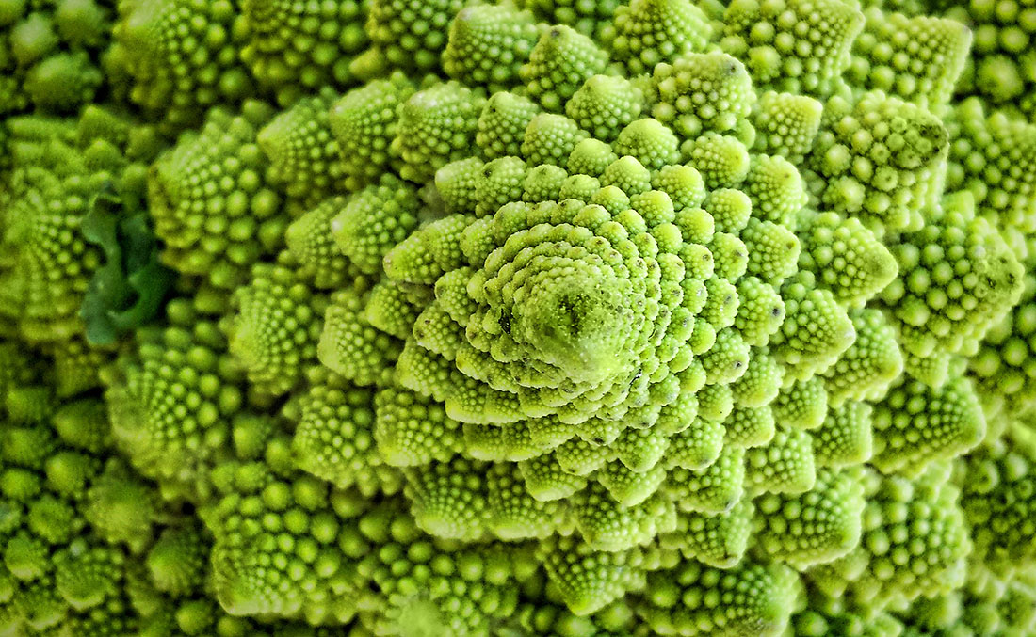
The essence of machine learning
A pattern exists
We cannot express it programmatically
We have data on it

Slide 29
What is machine learning?
[Arthur Samuel, 1959] field of study that:
gives computers the ability to learn without being explicitly programmed
[Kevin Murphy] algorithms that:
automatically detect patterns in data
use the uncovered patterns to predict future data or other outcomes of interest
[Tom Mitchell] algorithms that:
improve their performance (P)
at some task (T)
with experience (E)

Slide 30
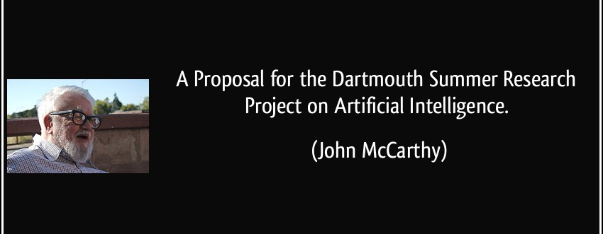
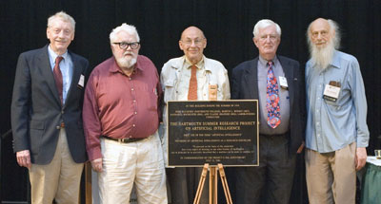
Brief history of AI

Slide 31
Brief history of AI
“We propose that a 2 month, 10 man study of artificial intelligence be carried out during the summer of 1956 at Dartmouth College in Hanover, New Hampshire.”
The study is to proceed on the basis of the conjecture that every aspect of learning or any other feature of intelligence can in principle be so precisely described that a machine can be made to simulate it.
An attempt will be made to find how to make machines use language, form abstractions and concepts, solve kinds of problems now reserved for humans, and improve themselves.
We think that a significant advance can be made in one or more of these problems if a carefully selected group of scientists work on it together for a summer.”

Slide 32
Brief history of AI
1960-1980s: ”AI Winter”
1990s: Neural networks dominate, essentially because of the discovery of the backpropagation for training neural networks with two or more layers
2000s: Kernel methods dominate, essentially because of the instability of training neural networks
2010s: The comeback of neural networks, essentially because of the discovery of deep learning

Slide 33
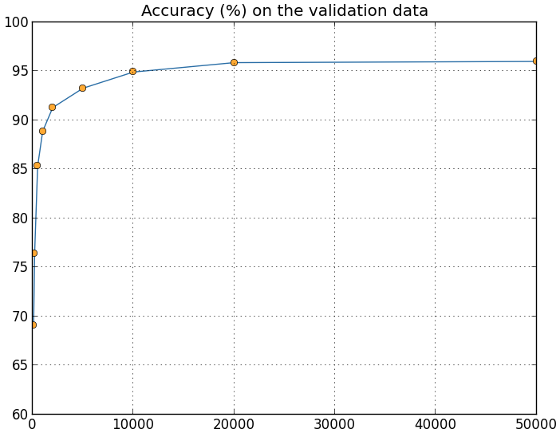
Why are things working today?
More compute power
More data
Better algorithms / models
Accuracy
Amount of Training Data

Slide 34
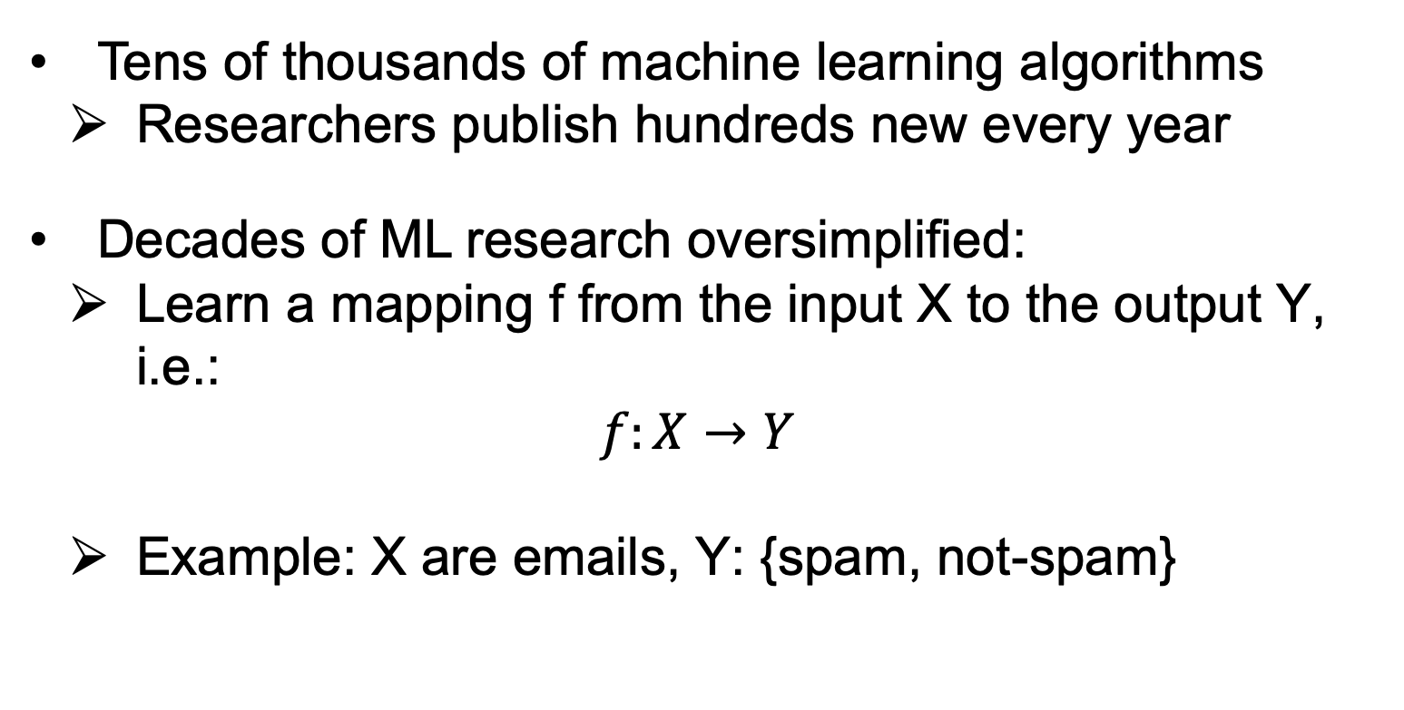
ML in a nutshell
Tens of thousands of machine learning algorithms
Researchers publish hundreds new every year
Decades of ML research oversimplified:
Learn a mapping f from the input X to the output Y, i.e.:
$$f:X→Y$$
Example: X are emails, Y: {spam, not-spam}

Slide 35
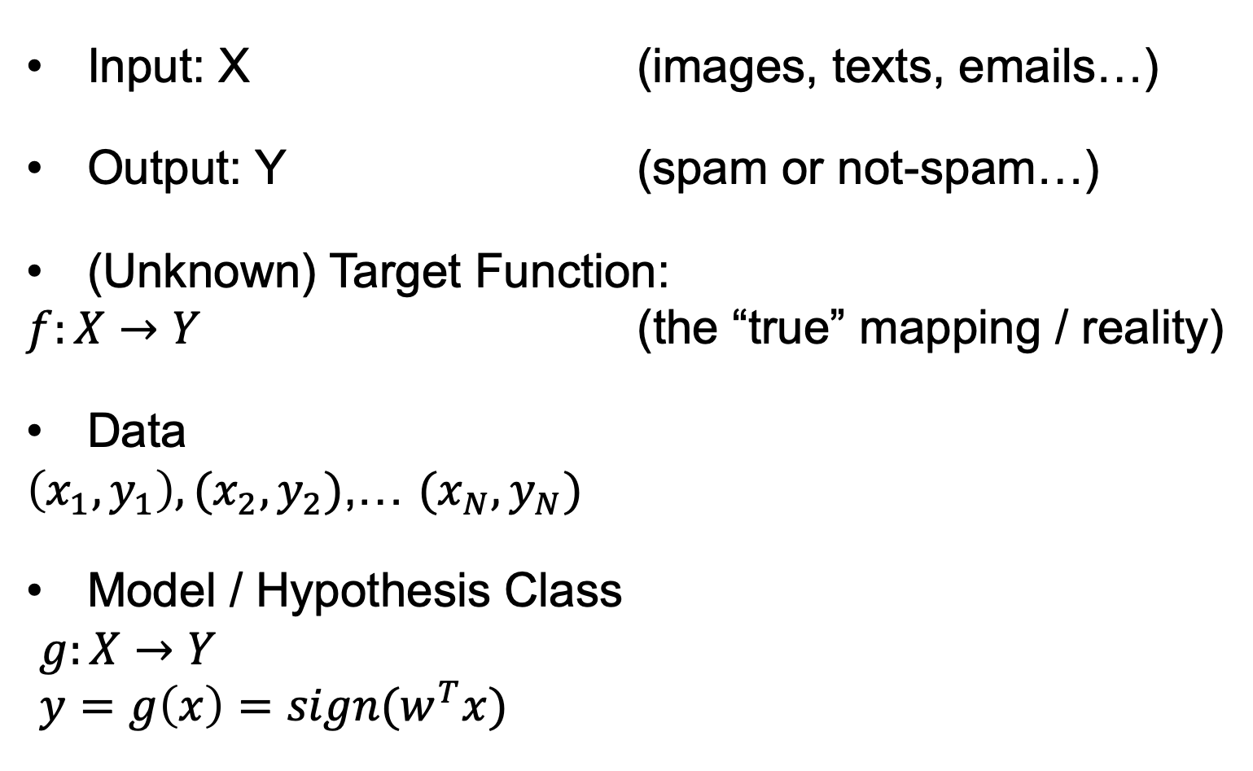
ML in a nutshell
Input: X (images, texts, emails…)
Output: Y (spam or not-spam…)
(Unknown) Target Function:
$f:X→Y$ (the “true” mapping / reality)
Data
$\left(x_{1},y_{1}\right),(x_{2},y_{2})$,… $(x_{N},y_{N})$
Model / Hypothesis Class
$g:X→Y$
$y=g\left(x\right)=sign(w^{T}x)$

Slide 36
ML in a nutshell
Every machine learning algorithm has three components:
Representation / Model Class
Evaluation / Objective Function
Optimization

Slide 37
Where does ML fit in?
Biology
Neuroscience
Applied Maths
Biology of learning
Inspiring paradigms
E.g.: neural networks
Optimization
Linear algebra
Derivatives
E.g.: local minimum
Machine Learning
Computer Science
Statistics
Algorithms
Data structures
Complexity analysis
E.g.: k-d trees
Estimation techniques
Theoretical frameworks
Optimality, efficiency
E.g.: Bayes rule

Slide 38
Learning paradigms
Standard learning paradigms:
Supervised learning
Unsupervised learning
Semi-supervised learning
Reinforcement learning
Non-standard paradigms:
Active learning
Transfer learning
Transductive learning

Slide 39
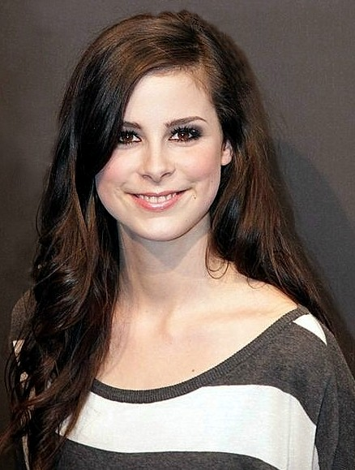
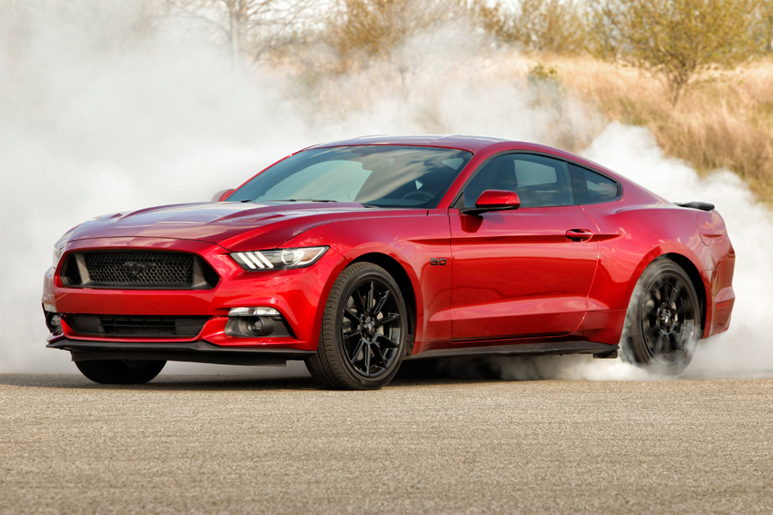
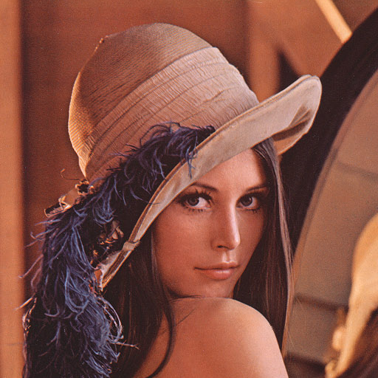
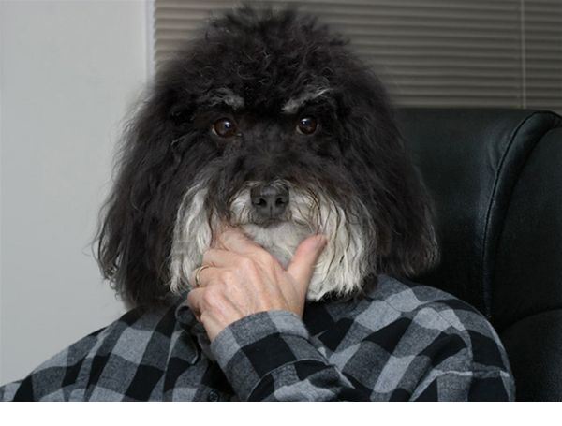
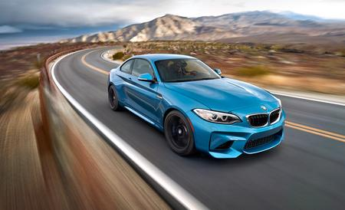
Supervised learning
We have a set of labeled training samples
Example 1: object recognition in images annotated with corresponding class labels
Car
Person
Person
Dog
Car

Slide 40
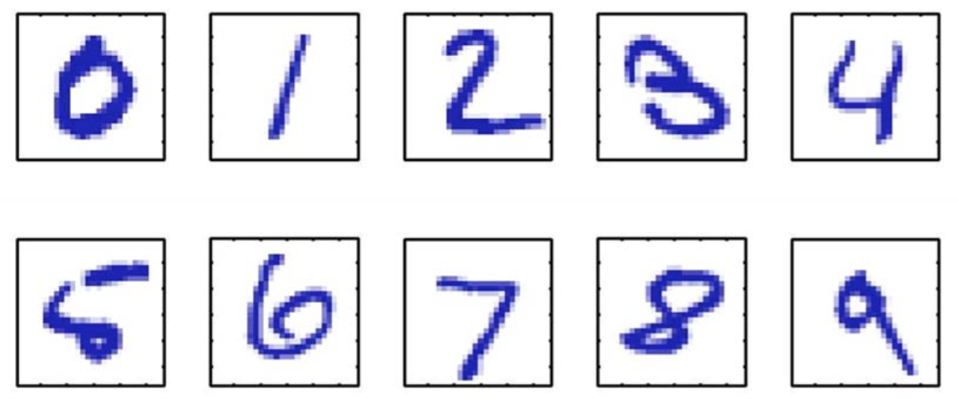
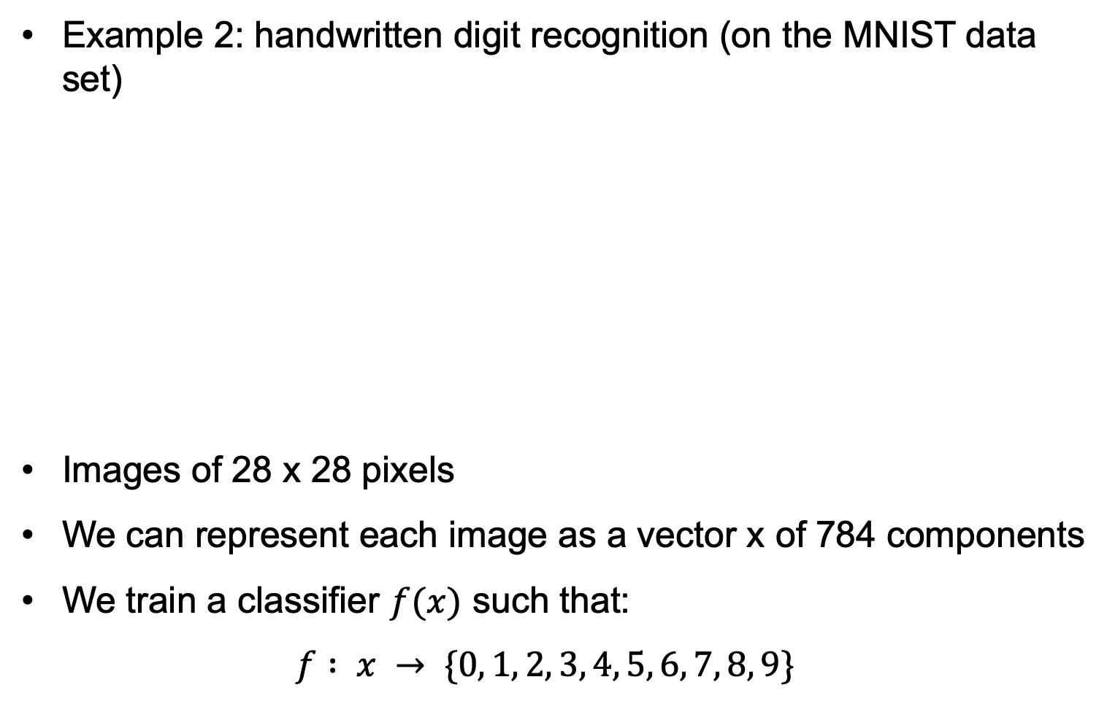
Supervised learning
Example 2: handwritten digit recognition (on the MNIST data set)
Images of 28 x 28 pixels
We can represent each image as a vector x of 784 components
We train a classifier $f(x)$ such that:
$$f : x → \{0, 1, 2, 3, 4, 5, 6, 7, 8, 9\}$$

Slide 41
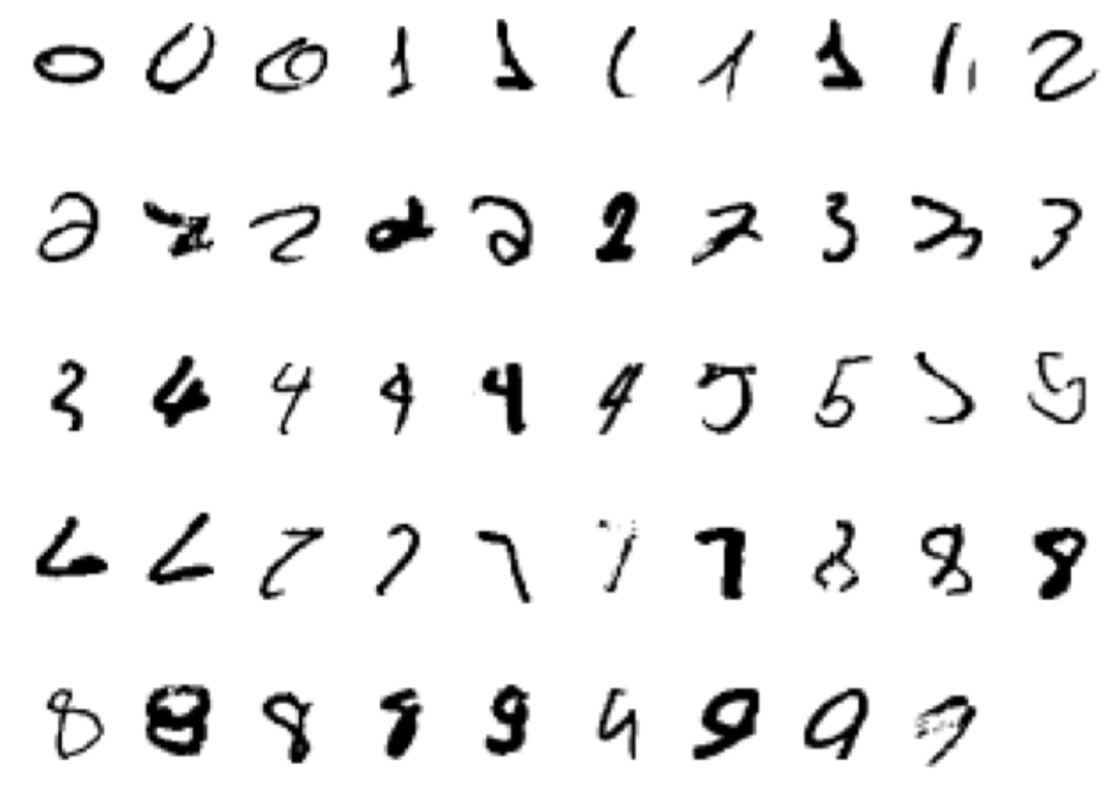
Supervised learning
Example 2 (continued): handwritten digit recognition (on the MNIST data set)
Starting with a training set of about 60K images (about 6000 images per class)
… the error rate can go down to 0.23% (using convolutional neural networks)
Among the first (learning-based) systems used in a large-scale commercial setting for postal code and bank cheque processing

Slide 42
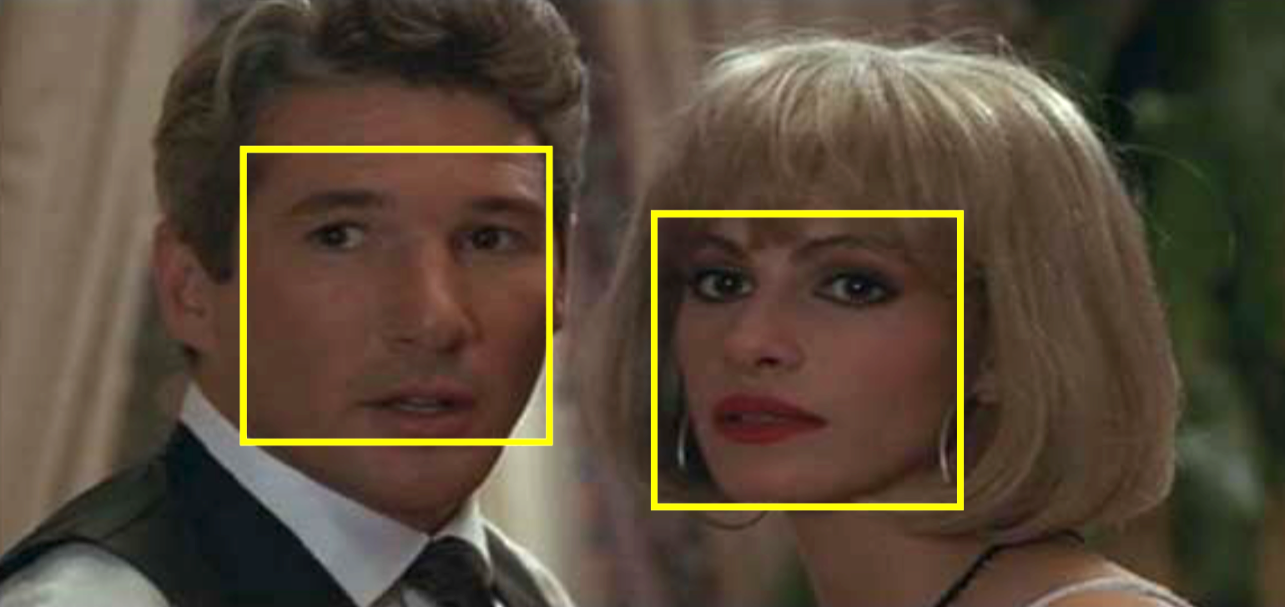
Supervised learning
Example 3: face detection
One approach consists of sliding a window over the image
The goal is to classify each window into one of the two possible classes: face or not-face
The original problem is transformed into a classification problem

Slide 43
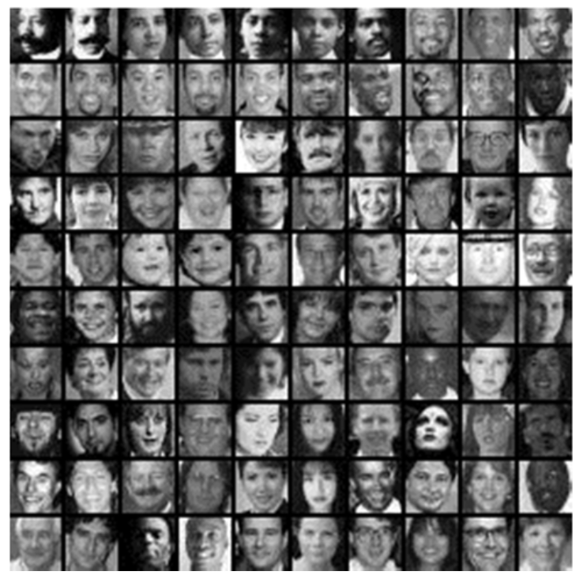
Supervised learning
Example 3: face detection
We start with a set of face images with different variations such as age, gender, illumination, pose, but no translations
… and a larger set of images that do not contain full faces

Slide 44
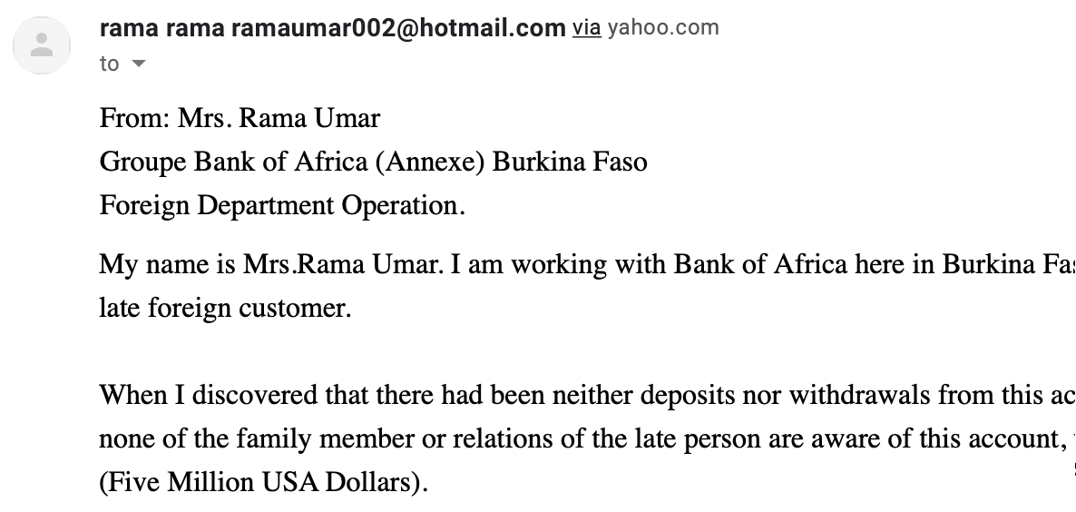
Supervised learning
Example 4: spam detection
The task is to classify an email into spam or not-spam
The occurrence of the word “Dollars” is a good indicator of spam
A possible representation is a vector of word frequencies

Slide 45
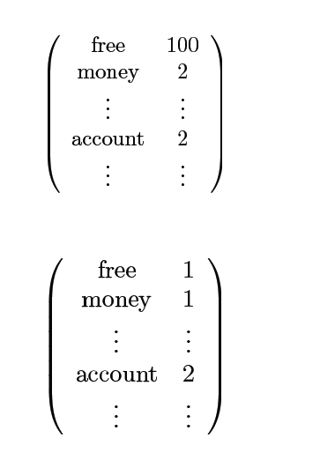
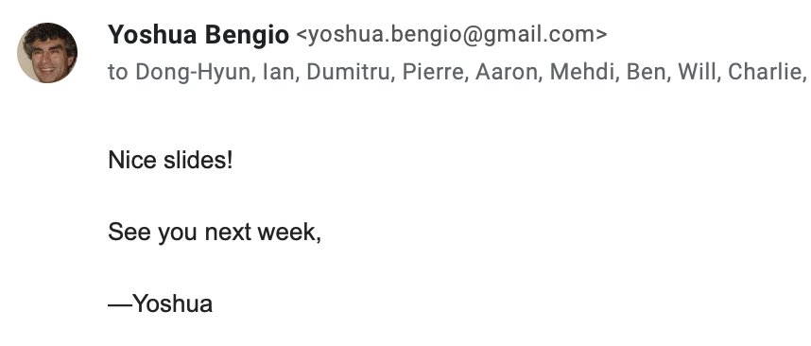
We count the words…
obtaining X

Slide 46
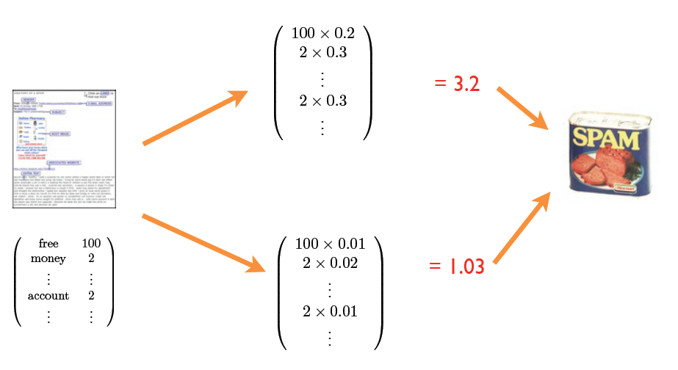
The spam detection algorithm
Confidence / performance guarantee?
Why linear combination?
Why these words?
Where do the weights come from?

Slide 47
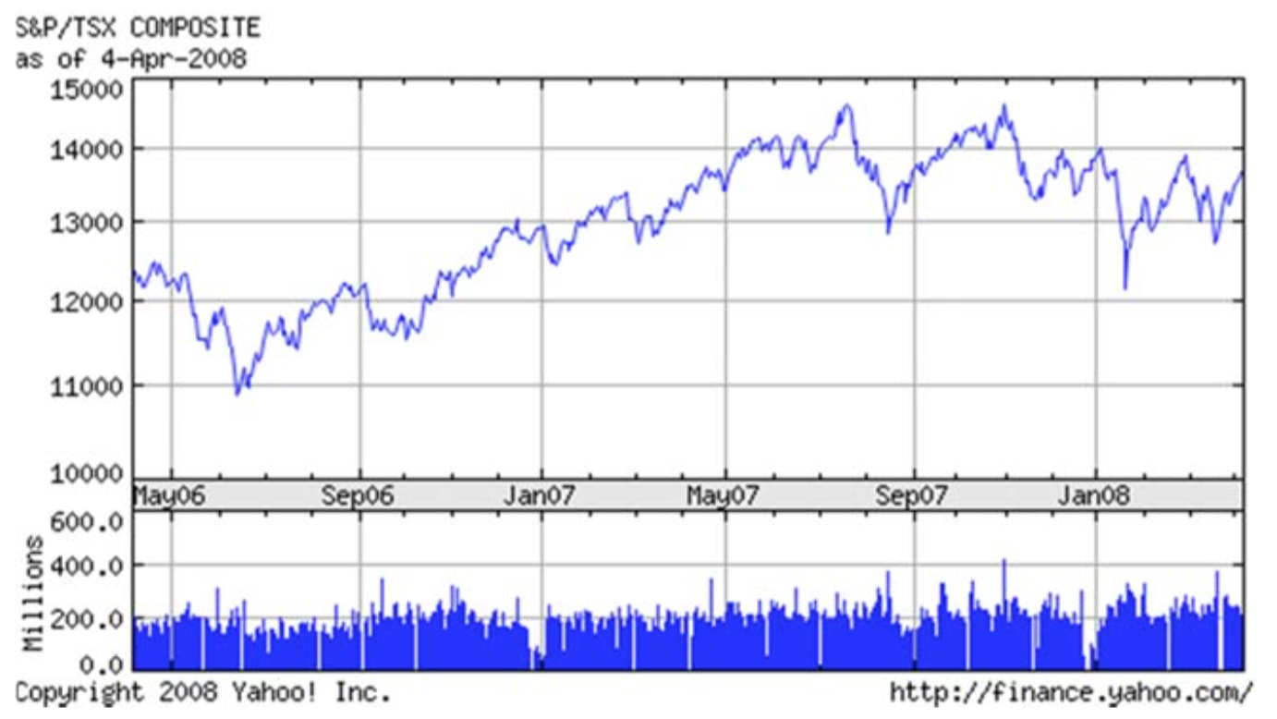
Supervised learning
Example 5: predicting stock prices on the market
The goal is to predict the price at a future date, for example in a few days
This is a regression task, since the output is continuous

Slide 48
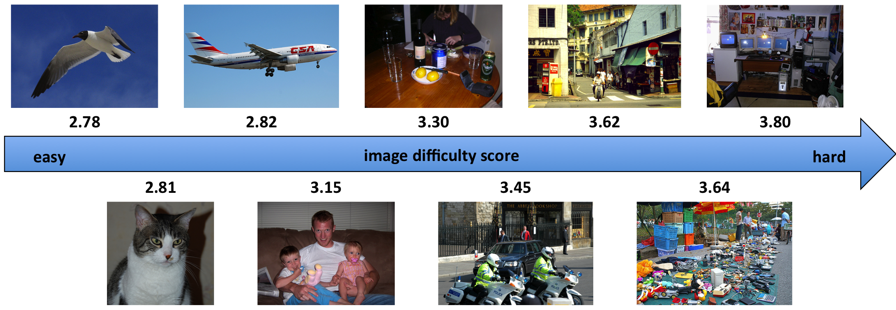
Supervised learning
Example 6: image difficulty prediction [Ionescu et al. CVPR2016]
The goal is to predict the time necessary for a human to solve a visual search task (data set available for project 2!)
This is a regression task, since the output is continuous

Slide 49
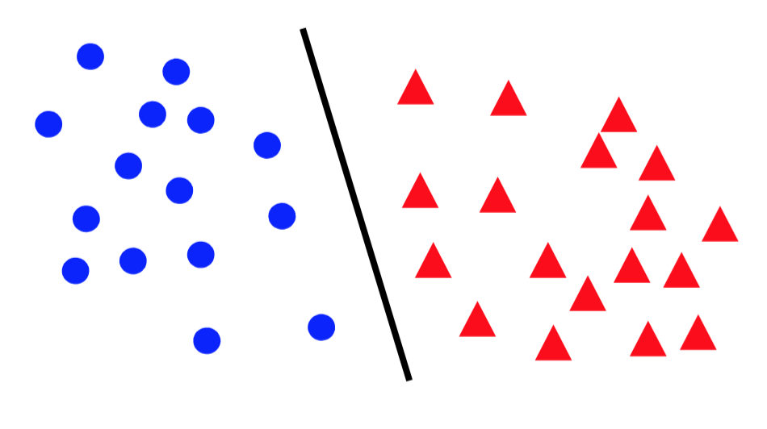
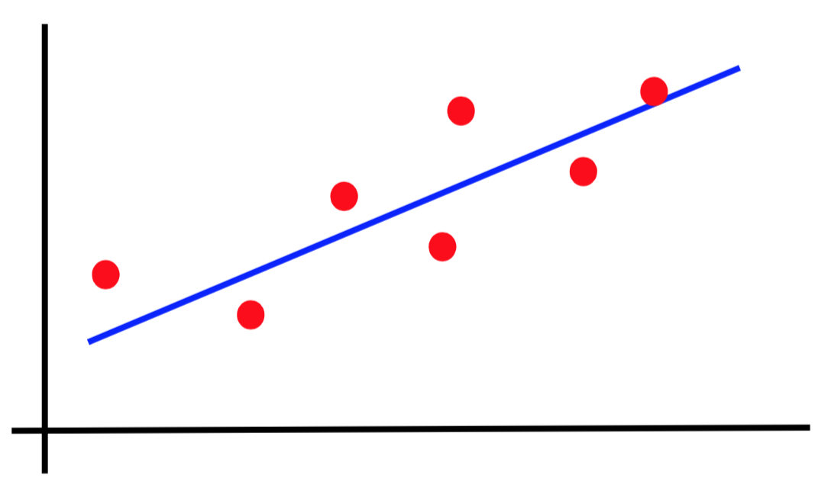
Canonical forms of supervised learning problems
Classification
Regression

Slide 50

Age estimation in images
Classification?
Regression?
What age?

Slide 51
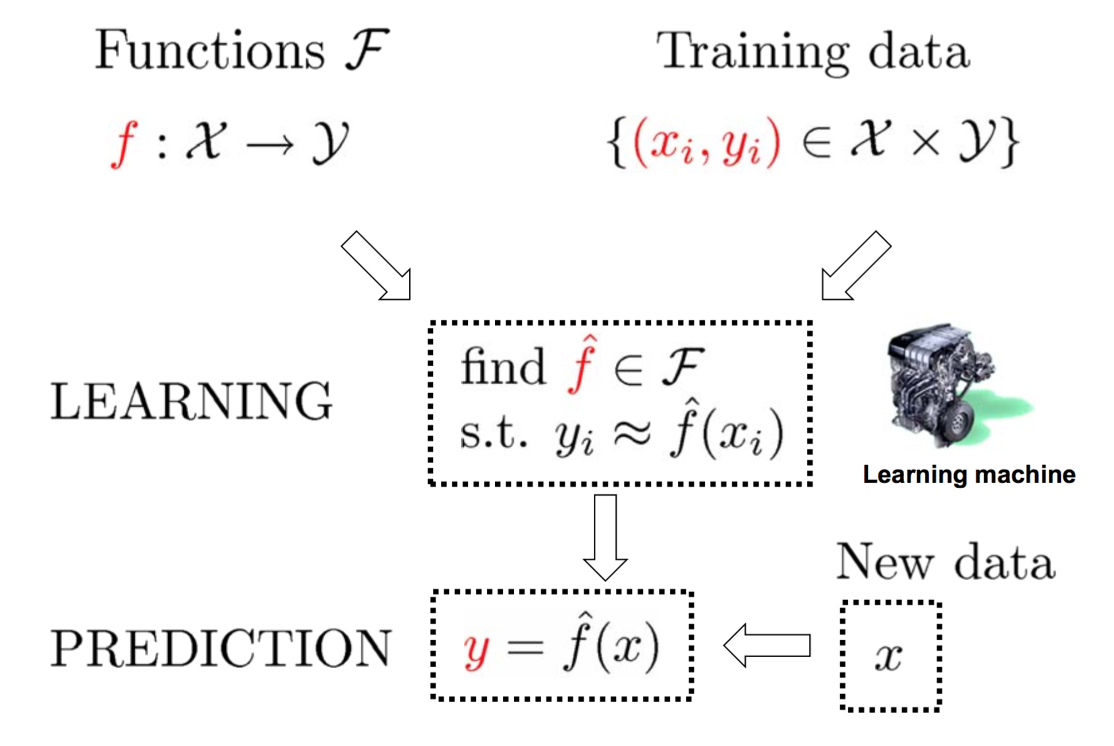
The supervised learning paradigm

Slide 52
Supervised learning models
Naive Bayes (lecture 2)
k-Nearest Neighbors (lecture 3)
Decision trees and random forests (lecture 4)
Support Vector Machines (lecture 5, 6)
Kernel methods (lecture 5)
Kernel Ridge Regression (lecture 5)
Neural networks (lectures 7, 8, 9)
Many others…

Slide 53
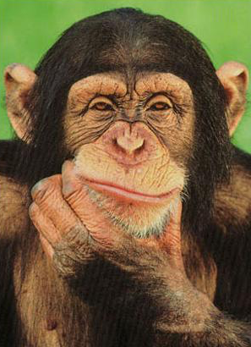
Unsupervised learning
We have an unlabeled training set of samples
Example 1: clustering images based on similarity

Slide 54
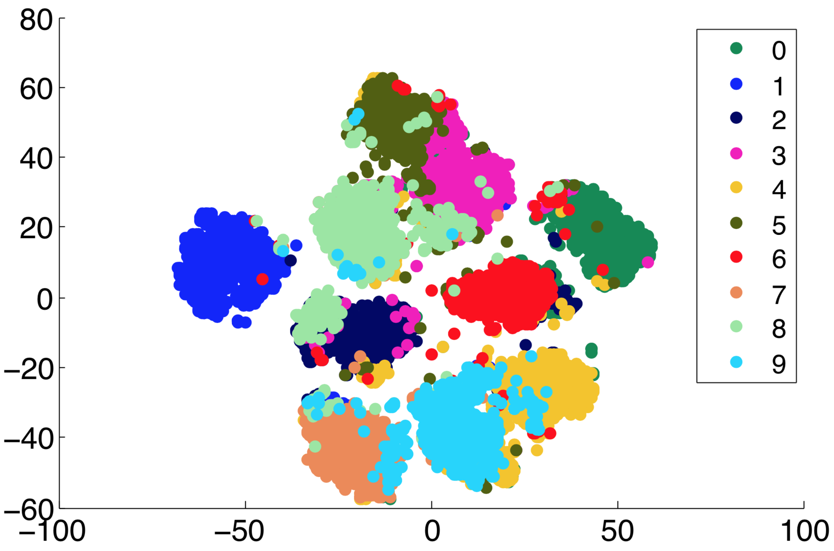
Unsupervised learning
Example 1: clustering MNIST images based on similarity [Georgescu et al. ICIP2019]

Slide 55
Unsupervised learning
Example 2: unsupervised features learning

Slide 56
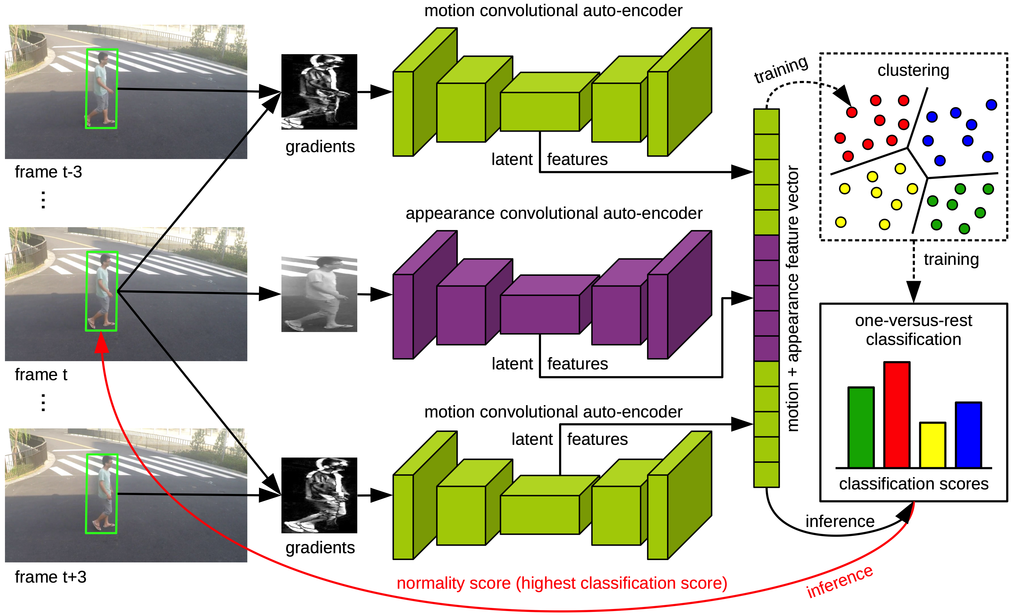
Unsupervised learning
Example 2: unsupervised features learning for abnormal event detection [Ionescu et al. CVPR2019]

Slide 57
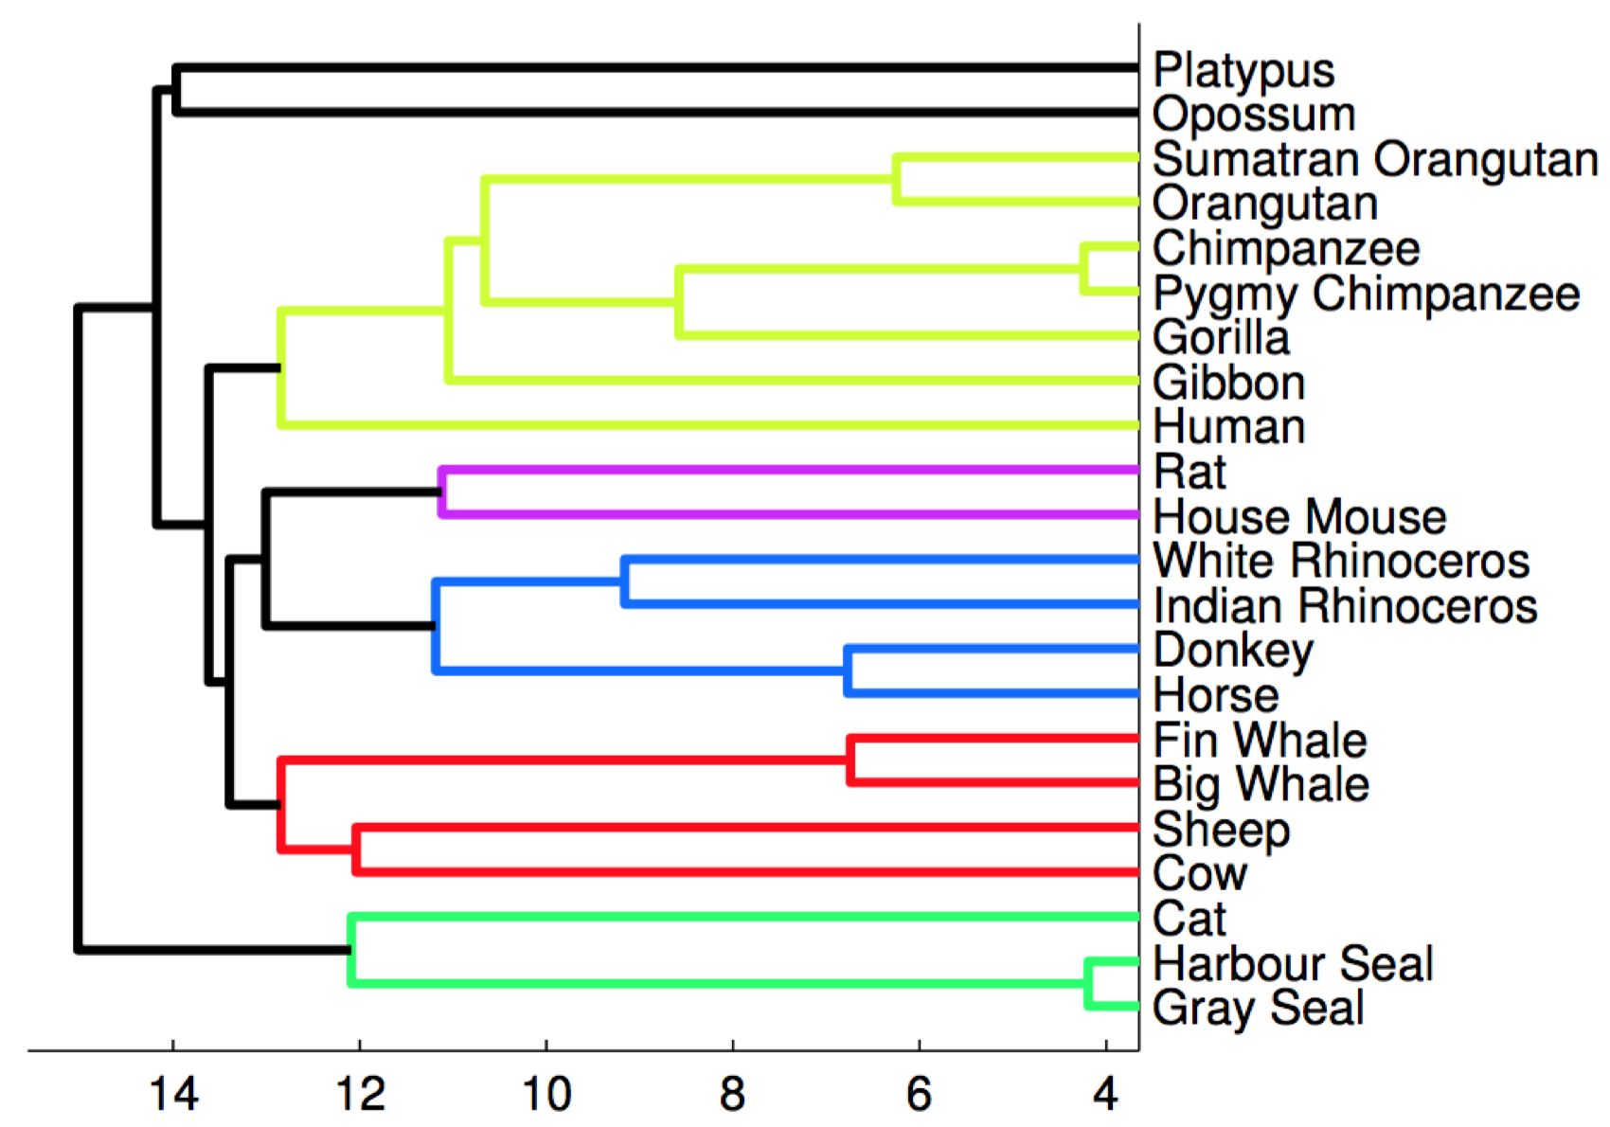
Unsupervised learning
Example 3: clustering mammals by family, species, etc.
The task is to generate the phylogenetic tree based on DNA

Slide 58
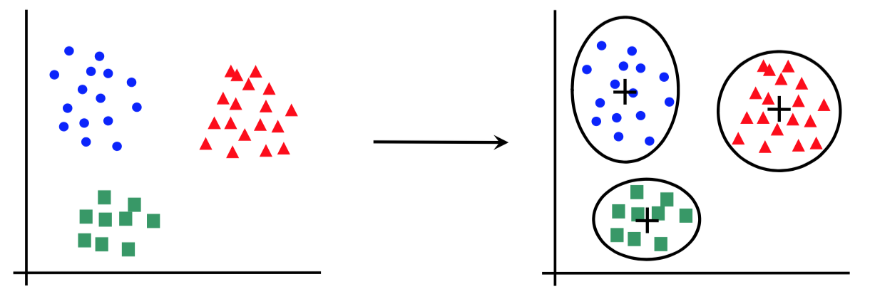
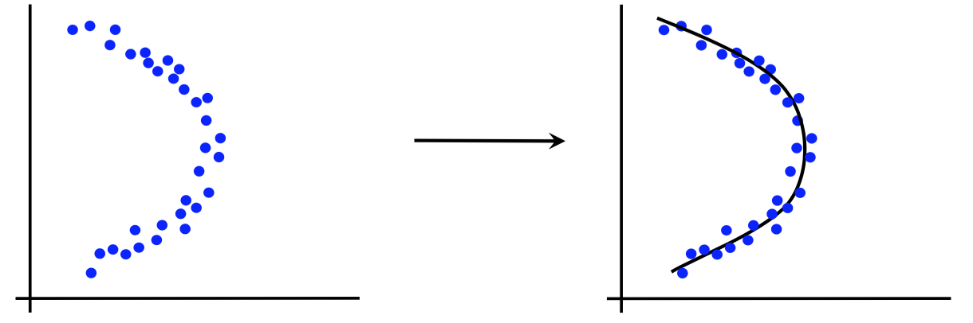
Canonical forms of unsupervised learning problems
Clustering
Dimensionality Reduction

Slide 59
Unsupervised learning models
K-means clustering (lecture 10, 11)
DBScan (lecture 12)
Hierarchical clustering (lecture 12)
Principal Component Analysis (lecture 13)
t-Distributed Stochastic Neighbor Embedding (lecture 13)
Hidden Markov Models
Many others…

Slide 60
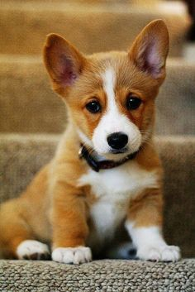
Semi-supervised learning
We have a training set of samples that are partially annotated with class labels
Example 1: object recognition in images, some of which are annotated with corresponding class labels
Car
Dog
Person

Slide 61
Reinforcement learning
How does it work?
The system learns intelligent behavior using a reinforcement signal (reward)
The reward is given after several actions are taken (it does not come after every action)
Time matters (data is sequential, not i.i.d.)
The actions of the system can influence the data

Slide 62
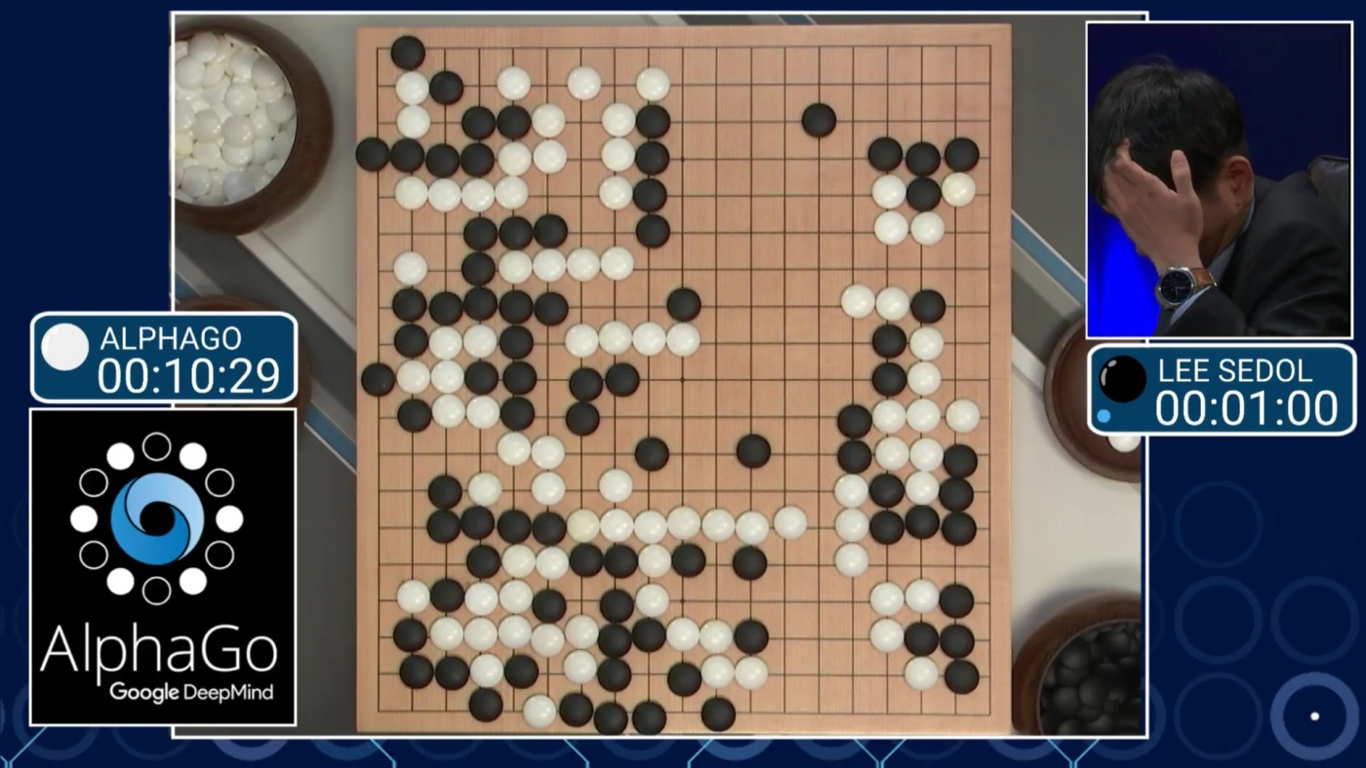
Reinforcement learning
Example 1: learning to play Go
+/- reward for winning / losing the game

Slide 63
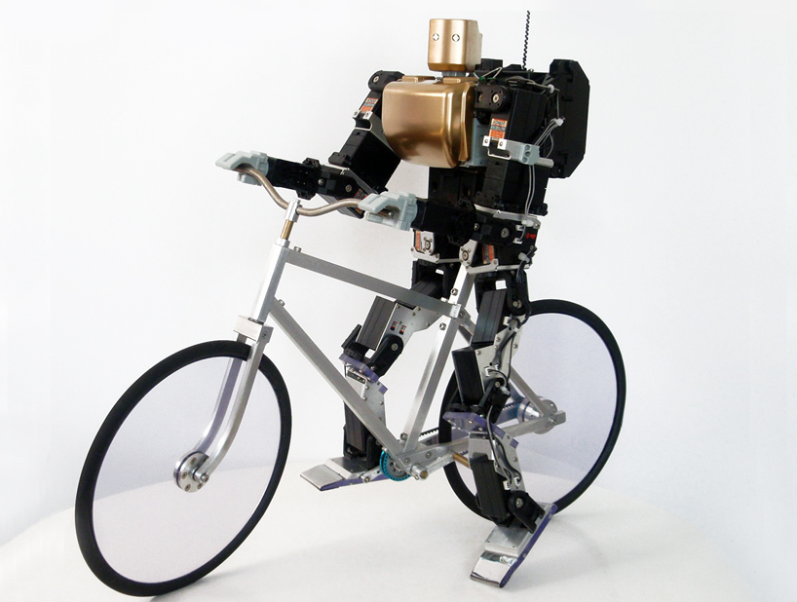
Reinforcement learning
Example 2: teaching a robot to ride a bike
+/- reward for moving forward / falling

Slide 64
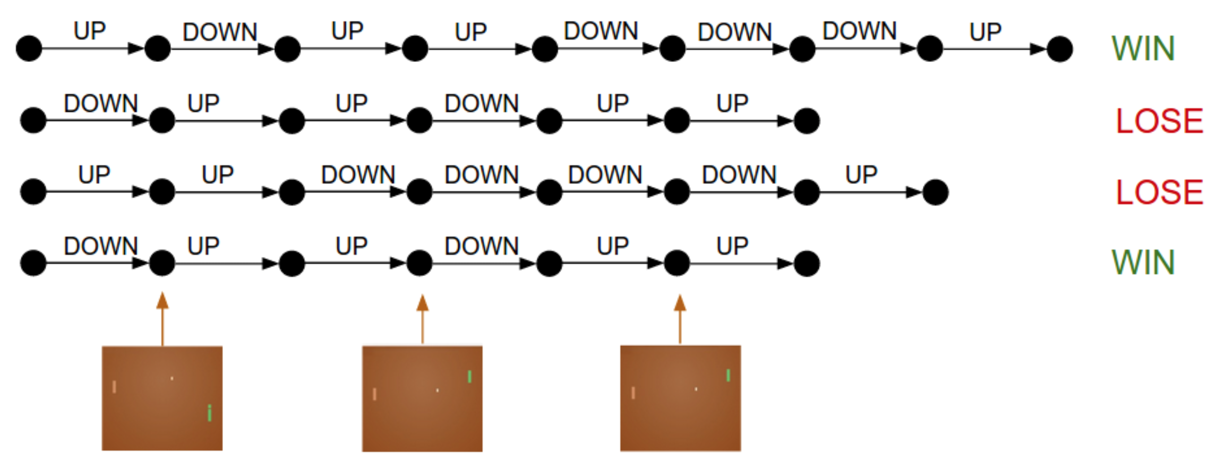
Reinforcement learning
Example 3: learning to play Pong from image pixels
+/- reward for increasing
personal / adversary score

Slide 65
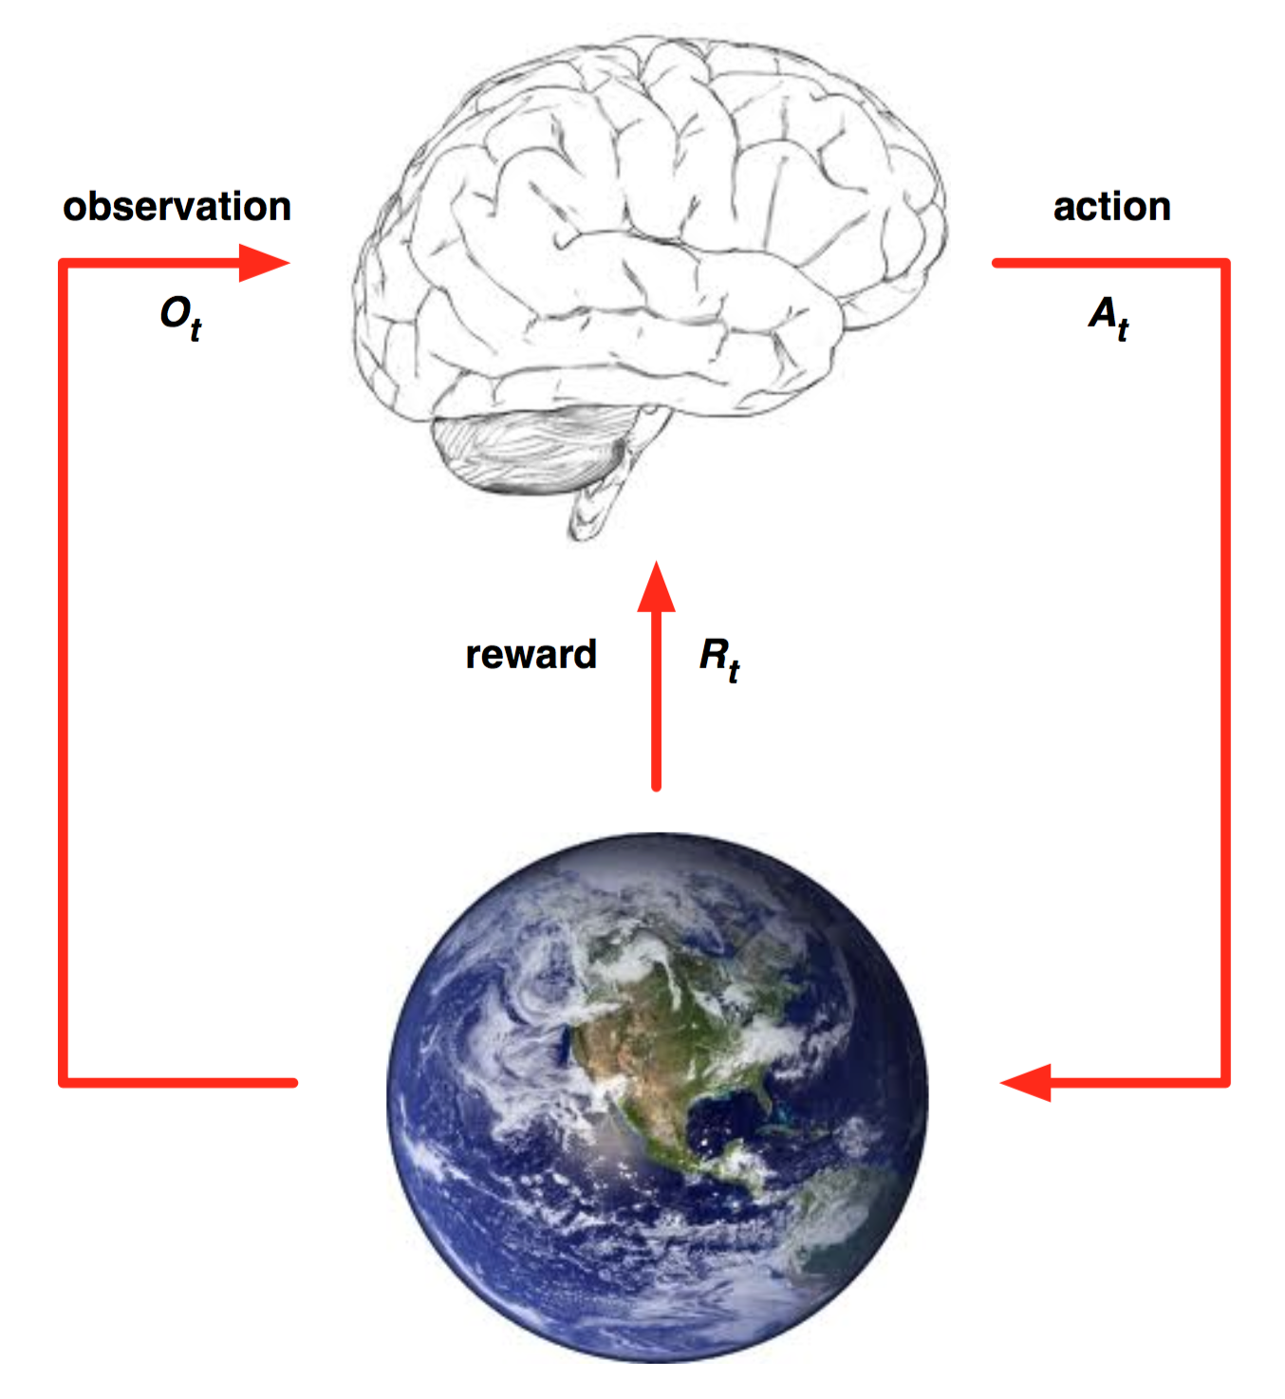
Reinforcement learning paradigm

Slide 66
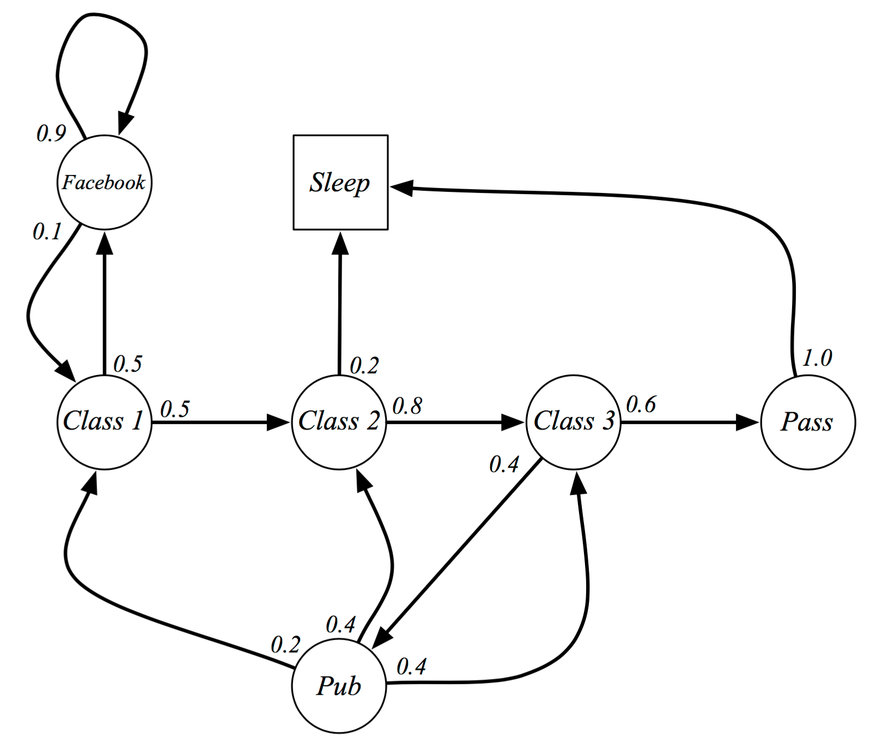
Formalizing as Markov Decision Process

Slide 67

Formalizing as Markov Decision Process

Slide 68
Formalizing as Markov Decision Process
Solution based on dynamic programming (small graphs) or approximation (large graphs)
Goal: select the actions that maximize the total final reward
The actions can have long-term consequences
Sacrificing the immediate reward can lead to higher rewards on the long term

Slide 69
Formalizing as Markov Decision Process
AlphaGo example:
Narrator 1: “That’s a very strange move”
Narrator 2: “I thought it was a mistake”
But actually, “the move turned the course of the game. AlphaGo went on to win Game Two, and at the post-game press conference, Lee Sedol was in shock.”
https://www.wired.com/2016/03/two-moves-alphago-lee-sedol-redefined-future/

Slide 70

Active learning
Given a large set of unlabeled samples, we have to choose a small subset for annotation in order to obtain a good classification model

Slide 71

Transfer learning
Starting with a model trained for a certain task / domain, use the model for a different task / domain
More specific object classes,
face recognition,
texture classification, etc.

Slide 72

Transfer learning
Adapt the model to specific test samples
Example 1: facial expression recognition [Georgescu et al. Access2019]

Slide 73

Transfer learning
Example 2: zero-shot learning

Slide 74

Many interesting applications, but…
What is ethical and what is not?
Trolley paradox

Slide 75

Many interesting applications, but…
What is ethical and what is not?
Trolley paradox

Slide 76
Many interesting applications, but…
What is ethical and what is not?
Trolley paradox
http://moralmachine.mit.edu

Slide 77
Bibliography

Slide 78


Slide 79


Slide 80


